Slide 1
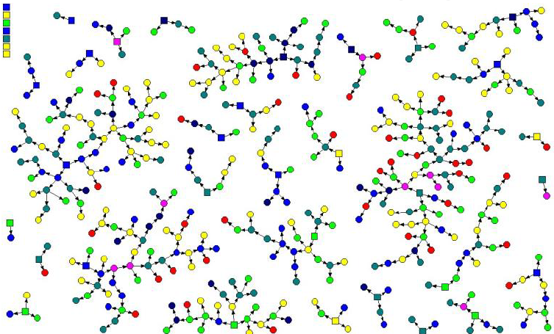
Paper: RESPONDENT DRIVEN SAMPLING: A NEW APPROACH TO SAMPLING RARE AND HIDDEN DISEASES Author(s): Arezoo Bagheri
Presented by:
Parastoo Bybordi
Fateme Lagha
Hoda Naseri

Slide 2
Introduction
The number and characteristics of people having with AIDS, drug users, child labor .etc. have been topics that have long been of interest to researchers.
Examining such populations, which are called rare, hidden or hardy because of their characteristics, requires its own methods. Hidden or hard-to-reach populations refer to subpopulations that typically make up 1 to 10 percent of the total population. One of the most important issues in studying these communities is finding their size.
There are different sampling methods such as retrieval sampling, snowball sampling, network sampling, etc. for these communities.
One of these methods is respondent driven sampling.

Slide 3
What is Respondent Driven Sampling?
This method was introduced by Douglas Heckathorn.
Responsive sampling combines snowball sampling with a mathematical model to weight the sample and reduce the non-random bias of the samples.
This method is a subset of adaptive sampling and follow-up of links.
It is used in situations where common sampling methods are unused.

Slide 4


Respondent Driven Sampling
Suitable for communities:
Immigrants in a country
Child labor
Drug users
People living with HIV
Jazz musicians

Slide 5
Respondent Driven Sampling
Unsuitable for communities with known sampling frame:
Students in a school
People who have received the flu vaccine.
Households below the poverty line) Poverty threshold)
This sampling method consists of two parts: membership recruitment strategy and components analysis.

Slide 6
Definitions:
Recruiter: In the recruitment process, all sample members are recruits, because they can introduce and recruit another person to the project.
Recruit: In the recruitment process, all sample members, except for the nuclei, which are introduced to the project by their member, are called members.
Seeds: These are the prototypes that researchers randomly select from the statistical population, and the first stage of recruiting a responsive sampling scheme from them begins. In this sampling method, the number of cores is often between 3 and 15 and in many hard-to-reach communities, this number reaches 29 cores.

Slide 7
Definitions:
Formative Assessment : It is an assessment that researchers make before conducting a quantitative interview with in-depth interviews, mapping, and observing the target population in order to gather the necessary information for the implementation of the project.
Social Networks: Social network is a social structure of people who are connected through one or two factors of dependence such as type of work, drug addiction, friendship, kinship, having similar interests, etc.
Degree or size of social network: This size is obtained by asking each participant about the number of people who are eligible to participate in the project and have seen these people in the time period specified in the project.
The probability of selection for each participant is proportional to that person's degree.

Slide 8
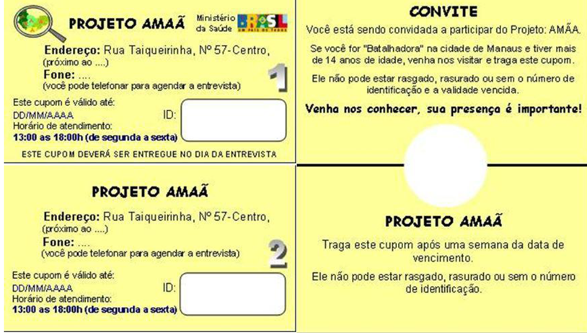
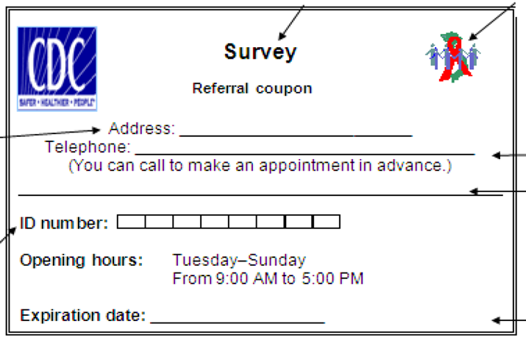
Definitions:
Coupon: Coupons are ,in fact, the quota of each person to join their counterparts in the plan, in which method often three coupons are delivered to each member. Coupons contain information about the design, working time and location of the survey staff, linking the recruiter and the member by assigning a unique identification number, assisting in the recruitment process and managing the allocation of incentives.

Slide 9

Definitions:
Incentives: Incentives in RDS are a reward for respecting the time and effort that participants devote to recruiting and participating in the project.There are two types of incentives:
Primary incentive: Incentives paid to the participant for participating in the sampling.
Secondary incentive: It is another incentive that the recruiter receives after joining the peers to participate in the project.
incentives such as food, clothing, etc. can be paid to the participants in the project.

Slide 10
Definitions:
Equilibrium: This concept originates from Markov's random chain model and indicates that the final sampling collected in the design is unbiased despite the non-random selection of cores.
In the sampling process, it is very important to achieve a stable composition of the key characteristics of the design.
It is recommended that the sampling process not be completed before reaching the equilibrium point, because at this point the sample becomes independent of non-randomly selected nuclei(peer).

Slide 11

Recruitment steps in RDS method:
Select seeds and interview them
Seeds membership training
Assign coupons to each of the seeds to recruit a qualified person
Interview of members introduced by Seeds if eligible
Giving opportunities and training if the new member agrees to recruit and allocate quotas to them
Seeds and recruiters will be rewarded for the people they introduce and interview.

Slide 12
Recruitment steps in RDS method:
Based on formative assessment, the seeds are non-randomly selected and receive coupons to recruit their counterparts. From every seed of the membership chain begins and begins to expand.
Seeds membership produces the first wave of sampling. The first wave generates the second wave and continues until a suitable sample is obtained.
The nucleus chain and the corresponding waves receive all sample members of the primary and secondary incentives (incentives are given to members without judging how to use these rewards).

Slide 13
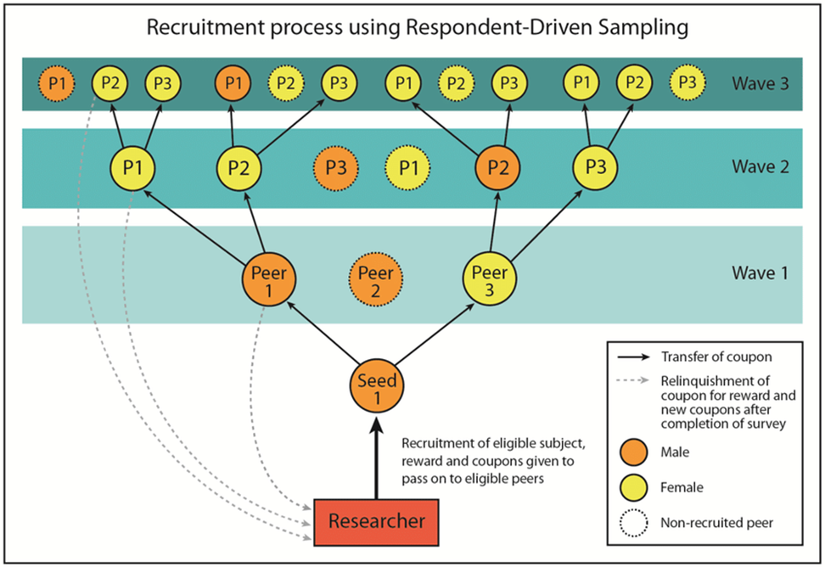
Recruitment steps in RDS method:

Slide 14
The purpose of RDS:
Generate large membership chains of several waves, so that the characteristics of the members of the final sample selected are independent of the characteristics of the seeds.
The final number of waves depends on the maximum number of waves in the longest chain.
In some respondent driven sampling, the number of these waves reaches 20.
The number of coupons used by each sample member during sampling is unpredictable.

Slide 15
How to choose the sample size?
Multiply the formulas of other sampling methods by the size of the design effect.
Effect of design: The ratio of variance of the estimate obtained from the desired sampling design to the variance of the estimate obtained from a simple random sample.
The size of the design effect is directly related to the number of sample sizes required for the design.

Slide 16
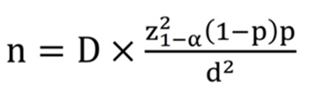
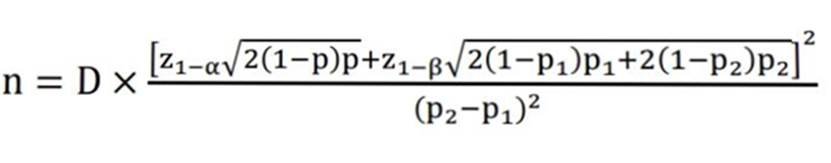
How to choose the sample size?
1- Sample size for the prevalence of an adjective(attribute):
2- Sample size to test changes in the estimation of an attribute over time:

Slide 17

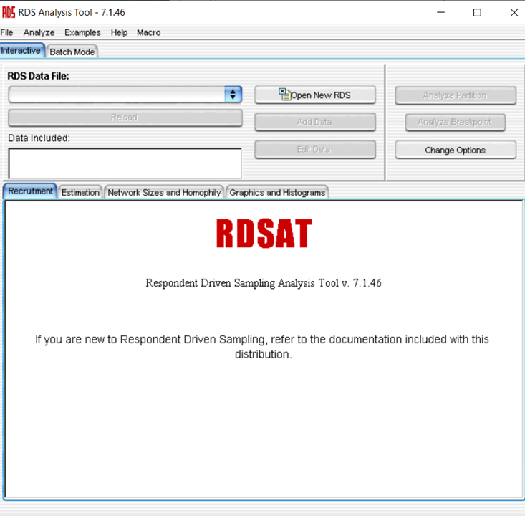
Software:
Package in R
RDS Analysis Tool (RDSAT)

Slide 18
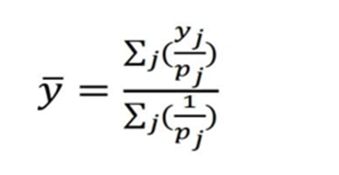
Hurwits-hansen estimator:
Estimation of the average of the desired variable:
𝑦 ̅: The average of the desired variable in the selected sample
𝑦_{j} : The value of the selected sample variable
P_{j} : Probability of selecting the J sample

Slide 19
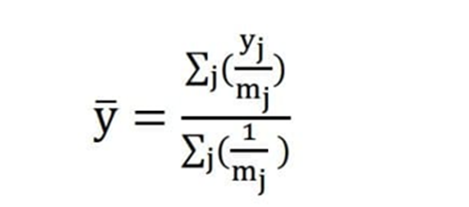
Hurwits-hansen estimator:
In this estimator, the probability of selecting a unit in the J selection is entered by assuming sampling by placing it in the calculation. The probability of selecting the same probability is assumed for all sample units.
Then:

Slide 20

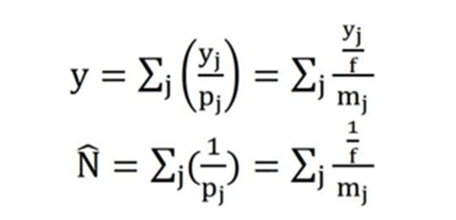
Hurwits-hansen estimator:
If f is a constant value proportional to and equal to the sampling fraction in the above equation, then the equation:
As a result, the total population of the variable and the size of the population are estimated as the following two equations:

Slide 21
Markov equilibrium:
Markov equilibrium: To achieve the Markov equilibrium and minimize the sample size estimate if the homophilic effect * is high, the sampling process must include a sufficient number of waves!
Now according to Watts, the number of sufficient waves: 6
Markov theory:
If there is a fixed number of conditions or positions, the probability of moving from one position to another can be calculated.
In this way, subsequent situations are dependent on current situations but are independent of previous situations that people have gone through.

Slide 22
Markov equilibrium:
Markov chain theory:
If peer recruitment occurs through a large and sufficient number of recruitment waves (called long chains); The individuals in the sample will represent the target population.
And in the next wave of recruitment, the representativeness of the sample does not change significantly.
Salganic and Heckathorn showed that:
The probability of selecting each participant is commensurate with the size of his or her social network -> the number of people he or she knows in the target community -> based on the Markov chain -> if estimates are asymptotically insignificant -> how the seeds are selected does not matter.

Slide 23
Implementation of RDS method in Iran:
Demonstrates the effectiveness of this method for studying the community of injecting drug users:
The purpose of estimation: Prevalence of HIV infection among injecting drug users from August 2006 to July 2007.
community of the project: They were injecting drug users who were addicted to injecting all kinds of drugs and had used drugs in the last 30 days. Eligible to participate in the project at the time of the project were 18 years of age or older and had membership vouchers. These individuals were asked to participate in HIV testing and oral interview. Individuals who had no effects of drug injection on their bodies could not describe the stages of drug injection or were unable to express their consent to participate in the project due to drugs or mental disorders were not eligible to participate in the project during the screening phase. .

Slide 24
Implementation of RDS method in Iran:
The seeds were selected through injecting drug users' associations or people referring to the HIV center. After announcing their verbal consent, the seeds participated in the project by maintaining the confidentiality of information, and after completing the primary incentive plan (five hundred tomans), health package ( Containing a sanitary syringe, cotton, medical alcohol, an educational brochure and the address of the HIV testing center, they received a referral letter to the HIV testing center and three membership coupons to refer their peers to the project.

Slide 25
Implementation of RDS method in Iran:
On the coupon, the name of the project, the address of the statistical headquarters, information about the responsible person in the statistical headquarters, the expiration date of the coupon (thirty days after the delivery date of the coupon) and the unique coupon number were indicated, indicating the contact between the recruiter and the member.
For each peer or member who completed the project, the recipient received a secondary incentive (one thousand tomans). .

Slide 26
Implementation of RDS method in Iran:
During the first phase of the project (14 weeks), 14 seeds were selected from the Iranian AIDS Research Center (ircha).
But they referred these nuclei to only five of their counterparts. During the 15th week, the amount of secondary incentives increased to 2,000 Tomans. And three more headquarters were added to the project's census headquarters. In order to prevent duplicate membership in this plan and to determine the credit of the person for participating in the plan, first the validity of the coupon and his date of birth were checked. A 12-digit code consisting of the first four letters of the words small name, first name, mother's name and city of birth was created. And most importantly, there was a person in charge at the headquarters to prevent duplicate recruits from attending the project.

Slide 27
Implementation of RDS method in Iran:
Four interviewers were used in this project. Three men who used to be injecting drug users, two of whom were HIV-positive, and a female helper who worked with injecting drug users and prostitutes.
All project staff were trained on the basics of the project to receive their non-judgmental responses from respondents and increase the validity of the responses, methods of establishing friendly relations with respondents and methods of maintaining the confidentiality of respondents' information.
Reliable organizations of injecting drug users stated in the implementation of the plan and the existence of their available census barriers in all areas of efficient and practical sampling.

Slide 28
Implementation of RDS method in Iran:
Questionnaire with items such as demographic characteristics, personal network information, type of drug used, injection syringe sharing behaviors, drugs or other drug-related equipment, drug use history and knowledge of behavior, ideas and experiences of the individual and There were a few other cases of AIDS.
After 10 minutes of consultation, blood tests were taken from the subjects. Then, people who were diagnosed with HIV were referred for further counseling for further investigation.
The initial sample size for the design was calculated using Equation 1 and considering the effect size of the design, 2, the value of alpha 0.05, the HIV prevalence rate of injecting drug users equal to 10% and the relative error of estimation of 3% equal to 762.

Slide 29
Implementation of RDS method in Iran:
Estimates with 95% confidence intervals were obtained using RDS analysis software and standard error of estimates was calculated through Bootstrap with 15,000 replications. Social Network Size 5 Respondents that were lost were moved through the median size of the social network based on their demographic variables, and you removed all cores from the data analysis.

Slide 30
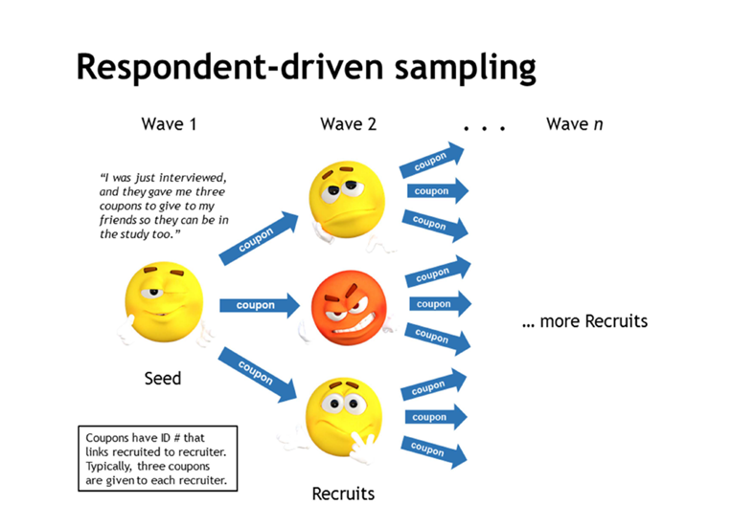
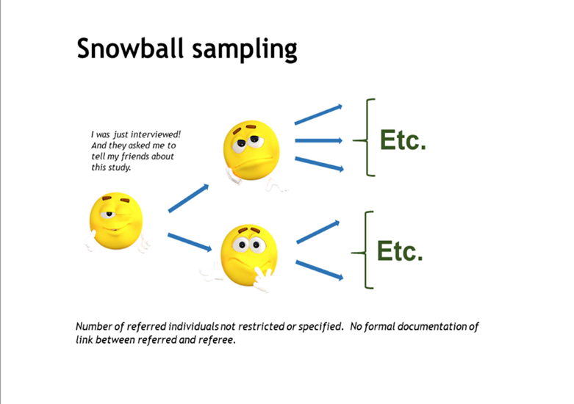
Comparison of advantages and disadvantages of sampling methods for hidden communities:
Purposive sampling
Place-time based on the occurrence of the event
snowball

Slide 31
Advantages of RDS compared to other methods:
Generates probabilistic samples and useful estimates of the target population.
It has significant external credibility
Compared to other methods, it requires less formative assessment / ethnographic evaluation.
More position control and creating a safe space for plan employees

Slide 32
Conclusion:
Responsive sampling method combines snowball sampling with mathematical models that assign weights to samples that eliminate biases due to non-random selections in the prototypes.
As a result, estimators with lower prevalence are generated. And confidence intervals are created for these estimators.
Given the benefits of this method, it is necessary to use this method for hidden and high-risk communities.

Slide 33
Other articles:
Sampling hard-to-reach populations with respondent driven sampling Lisa G. Johnstona and Keith Sabinb
How to Implement Respondent-Driven Sampling in Practice: Insights from Surveying 24-Hour Migrant Home Care Workers
EFFICIENCY OF RESPONDENT DRIVEN SAMPLING TO STUDY STREET CHILDREN(BAGHERI AREZOO)
FACTORS AFFECTING THE DESIGNING OF SAMPLING METHOD FOR HIDDEN POPULATIONS EXPOSED TO HIGH RISK DISEASES(SAADATI MAHSA, BAGHERI AREZOO)

Slide 34
References:
https://sociology.cornell.edu/douglas-heckathorn
http://www.respondentdrivensampling.org
https://researchforevidence.fhi360.org/emojis-convey-language-why-not-sampling-lesson
https://www.sid.ir/fa/journal/ViewPaper.aspx?ID=319496
https://www.sid.ir/fa/journal/ViewPaper.aspx?ID=319260
https://www.sid.ir/fa/journal/ViewPaper.aspx?ID=305091
https://journals.sagepub.com/doi/pdf/10.4256/mio.2010.0017
https://www.jhsph.edu/departments/population-family-and-reproductive-health/_docs/seminar-2012-10-31-rds.pdf
http://hivhub.ir/wp-content/uploads/2018/07/Respondent-Driven-Sampling.pdf

